Slide 1
Files

Slide 2
Objectives
After studying this section, you should be able to:
What is a file?
How are data stored in files?
How to access data in files?

Slide 3
Contents
What is a file?
Why do we need File Handling in C?
Types of Files in C
C File Operations: Open, Close, Create, Read, Write, …

Slide 4
1. What is a file?

Slide 5
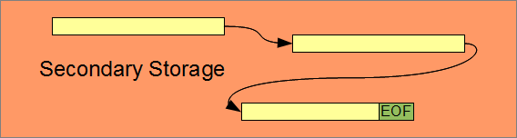
What is a file?
A file is a named area of secondary storage.
The file may be fragmented; that is, it may consist of several parts stored at different non-contiguous locations in secondary memory.
A file does not necessarily occupy contiguous space on the storage device.
The byte is the fundamental storage unit of a file. The distinguishing feature of a file is the end-of-file mark. We refer to this mark as EOF (EOF typically has the value -1)

Slide 6
2. Why do we need File Handling in C?

Slide 7
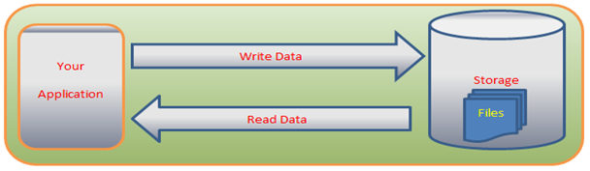
Why do we need File Handling in C?
The operations using the C program are done on a prompt/terminal which is not stored anywhere.
The output is deleted when the program is closed.
However, in the software industry, most programs are written to store the information fetched from the program. The use of file handling is exactly what the situation calls for.

Slide 8
Why do we need File Handling in C?
Reusability: The data stored in the file can be accessed, updated, and deleted anywhere and anytime providing high reusability.
Portability: Without losing any data, files can be transferred to another in the computer system. The risk of flawed coding is minimized with this feature.
Efficient: A large amount of input may be required for some programs. File handling allows you to easily access a part of a file using few instructions which saves a lot of time and reduces the chance of errors.
Storage Capacity: Files allow you to store a large amount of data without having to worry about storing everything simultaneously in a program.

Slide 9
3. Types of Files in C

Slide 10
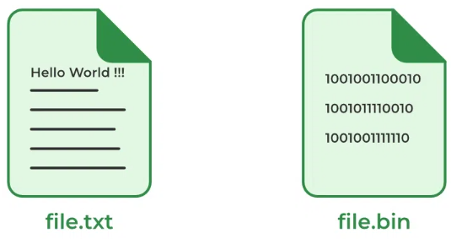
Type of Files in C
A file can be classified into two types based on the way the file stores the data. They are as follows:
Text Files
Binary Files

Slide 11
Text Files
A text file contains data in the form of ASCII characters and is generally used to store a stream of characters.
Each line in a text file ends with a new line character (‘\n’).
It can be read or written by any text editor.
They are generally stored with .txt file extension.
Text files can also be used to store the source code.

Slide 12
Binary Files
A binary file contains data in binary form (i.e. 0’s and 1’s) instead of ASCII characters. They contain data that is stored in a similar manner to how it is stored in the main memory.
The binary files can be created only from within a program and their contents can only be read by a program.
More secure as they are not easily readable.
They are generally stored with .bin file extension.

Slide 13
Type of Files in C (cont.)
01000001
01000010
01000011
00110010
00110110
00110000
Characters
“ABC”
01000001 (‘A’)
01000010 (‘B’)
01000011 (‘C’)
00000000 (NULL)
Text file
ASCII codes
of digits
Data
00110010 (‘2’)
00110110 (‘6’)
00110000 (‘0’)
Number
260 (2 bytes)
convert
00000001
00000100
Binary
file
00000001
00000100
Text format is more portable than binary format
But binary format is more efficient than text format

Slide 14
4. C File Operations

Slide 15
Operations on Files
There are different kinds of file operations in C:
Creating a new file
Opening an existing file
Reading from file
Writing to a file
Moving to a specific location in a file
Closing a file

Slide 16
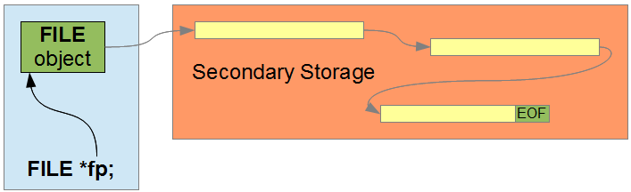
4.1. Connection to File
A C program connects to a file through an object of FILE type.
We use a library function to retrieve the address of the file object, store that address in a pointer and subsequently access the file through that pointer called File Pointer.

Slide 17

4.1. Connection to File (cont.)
Allocating a pointer to a FILE object takes the form:
Where FILE is the type of the FILE object and identifier is the name of the pointer to the FILE object. We call this pointer a handle to the object.
The structure type FILE is declared in the <stdio.h> header file. To allocate memory for a FILE pointer, we write:
FILE *identifier;

Slide 18
4.2. Open a File in C
For opening a file in C, the fopen() function is used with the filename or file path along with the required access modes.
Syntax:
Parameters:
file_name: name of the file when present in the same directory as the source file. Otherwise, full path.
access_mode: Specifies for what operation the file is being opened.
Return Value:
If the file is opened successfully, returns a file pointer to it.
If the file is not opened, then returns NULL.
FILE* fopen(const char *file_name, const char *access_mode);

Slide 19
File opening modes in C
Mode | Description | Example
r | Opens a text file in read-only mode, allowing only reading operations. | fopen("demo.txt", "r")
w | When using the mode "w", fopen() initializes a text file for writing exclusively. If the file already exists, it clears its contents; otherwise, it creates a new file for writing. | fopen("demo.txt", "w")
a | When employing the "a" mode, fopen() enables opening a text file in append mode. This mode permits writing data to the end of the file, preserving existing content. | fopen("demo.txt", "a")
r+ | When using the "r+" mode, fopen() facilitates opening a text file for both reading and writing operations. This mode grants the ability to manipulate data at any position within the file. | fopen("demo.txt", "r+")
w+ | This mode opens a text file for both reading and writing. If the file with same name already exists, it truncates the file to zero length; otherwise, it creates a new file for both reading and writing operations. | fopen("demo.txt", "w+")

Slide 20
File opening modes in C (cont.)
Mode | Description | Example
a+ | This mode opens a text file for both reading and writing, enabling data to be appended to the end of the file without overwriting existing content. | fopen("demo.txt", "a+")
rb | Opens a binary file in read-only mode, allowing reading operations on binary data. | fopen("demo.bin", "rb")
wb | Opens a binary file in write-only mode, truncating the file to zero length if it exists or creating a new file for writing binary data. | fopen("demo.bin", "wb")
ab+ | This mode opens a binary file for both reading and writing operations, allowing binary data to be appended to the end of the file without overwriting existing content. | fopen("demo.bin", "ab+")
rb+ | Opens a binary file for both reading and writing operations on binary data. | fopen("demo.bin", "rb+")
wb+ | Opens a binary file for both reading and writing operations, truncating the file to zero length if it exists or creating a new file for reading and writing binary data. | fopen("demo.bin", "wb+")

Slide 21
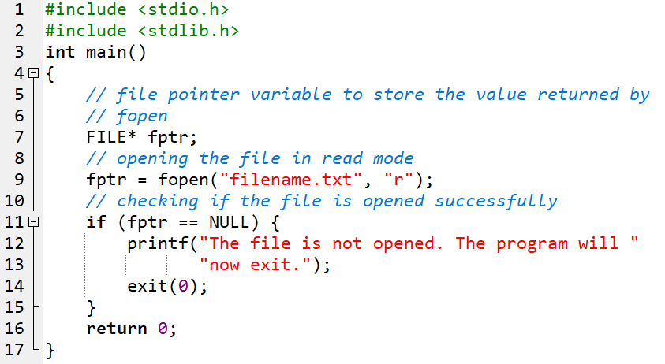
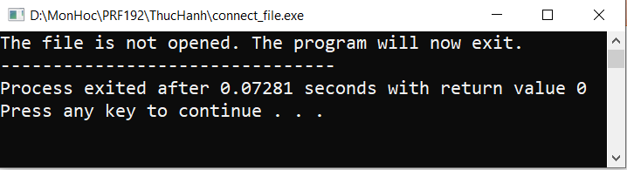
Example of Opening a File

Slide 22
4.3. Create a File in C
The fopen() function can not only open a file but also can create a file if it does not exist already.
Use the modes that allow the creation of a file if not found such as w, w+, wb, wb+, a, a+, ab, and ab+.
Syntax:
FILE *fptr;
fptr = fopen("filename.txt", "w");

Slide 23

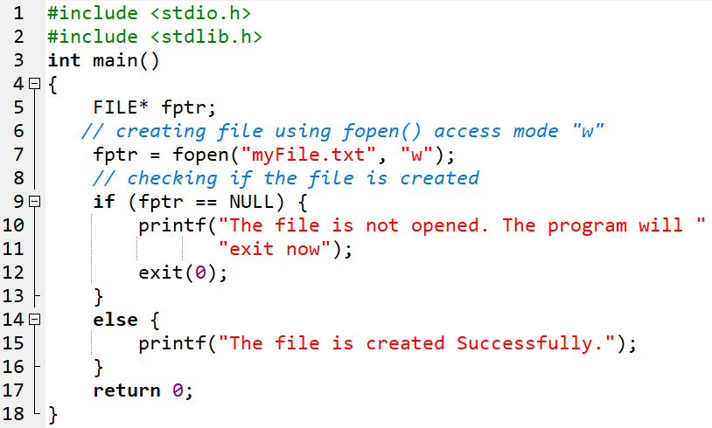
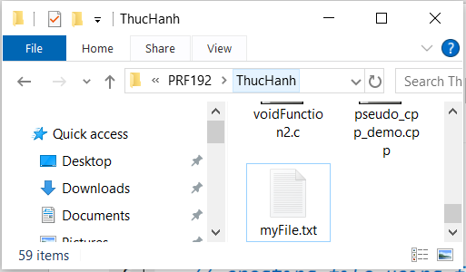
Example of Create a File

Slide 24
4.4. Reading From a File
Using the functions to read data from a file
Mode | Description
fscanf() | Retrieves input from a file using a formatted string and variable argument list.
fgets() | Obtains a complete line of text from the file.
fgetc() | Reads a single character from the file.
fgetw() | Reads a numerical value from the file.
fread() | Extracts a specified number of bytes from a binary file.

Slide 25
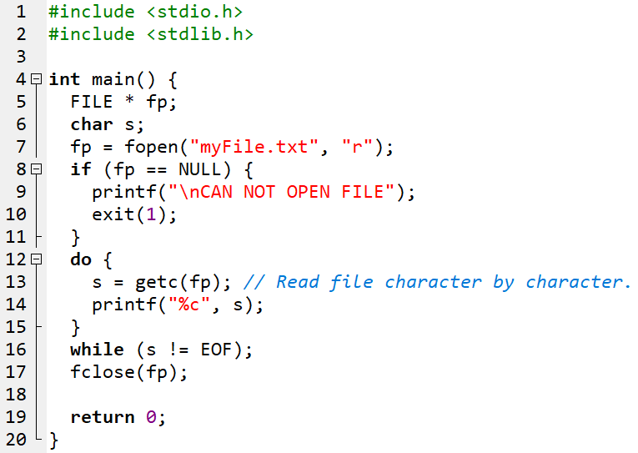
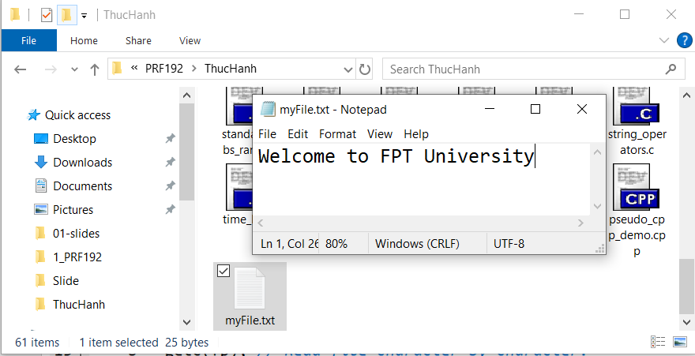

4.4. Reading From a File: Example

Slide 26
4.5. Write to a File
Using the functions to write data to a file
Mode | Description
fprintf() | This function, akin to printf(), uses a formatted string and variable arguments list to print output to the file.
fputs() | Prints an entire line in the file along with a newline character at the end.
fputc() | Writes a single character into the file.
putw() | Writes a number to the file.
fwrite() | Writes the specified number of bytes to the binary file.

Slide 27
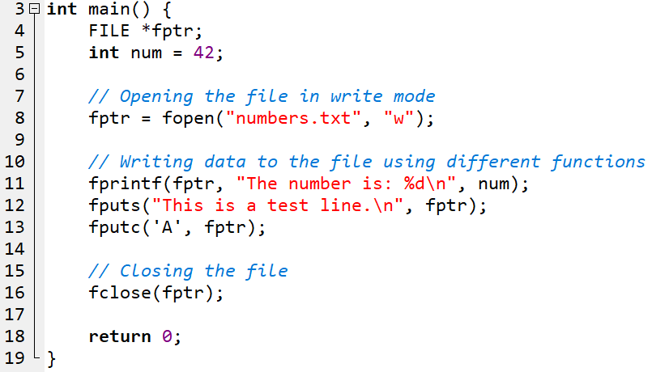
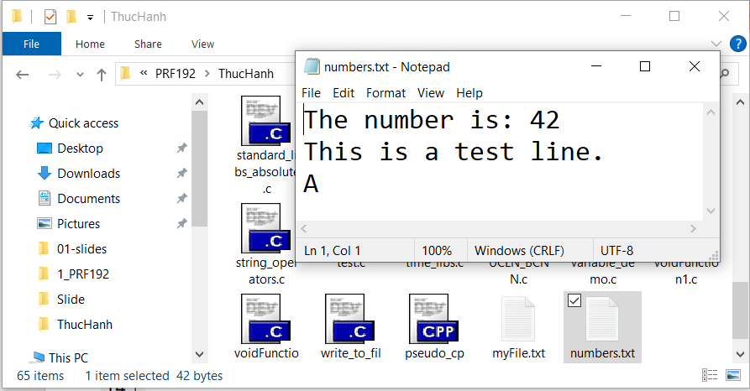
4.5. Write to a File: Example

Slide 28
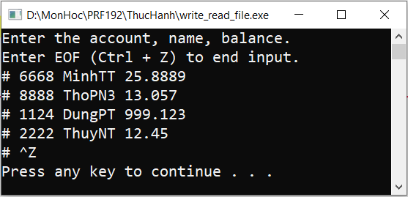
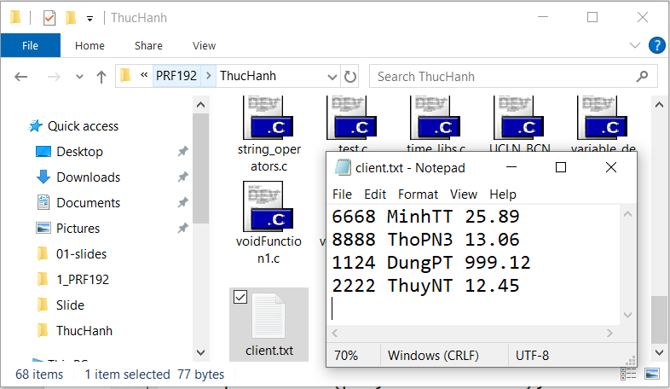
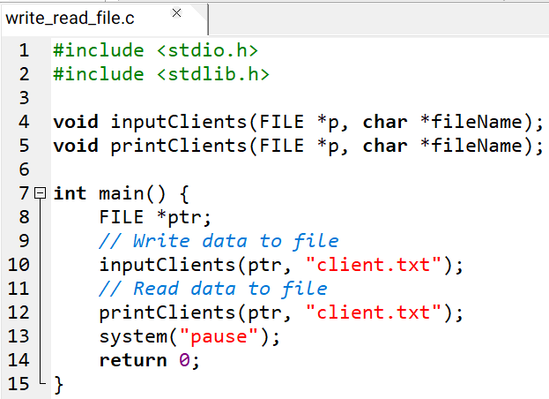
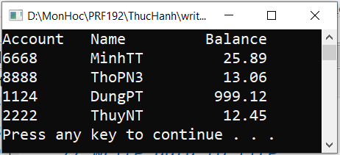
Demo: Program Write and Read text file
1
1
2
2

Slide 29
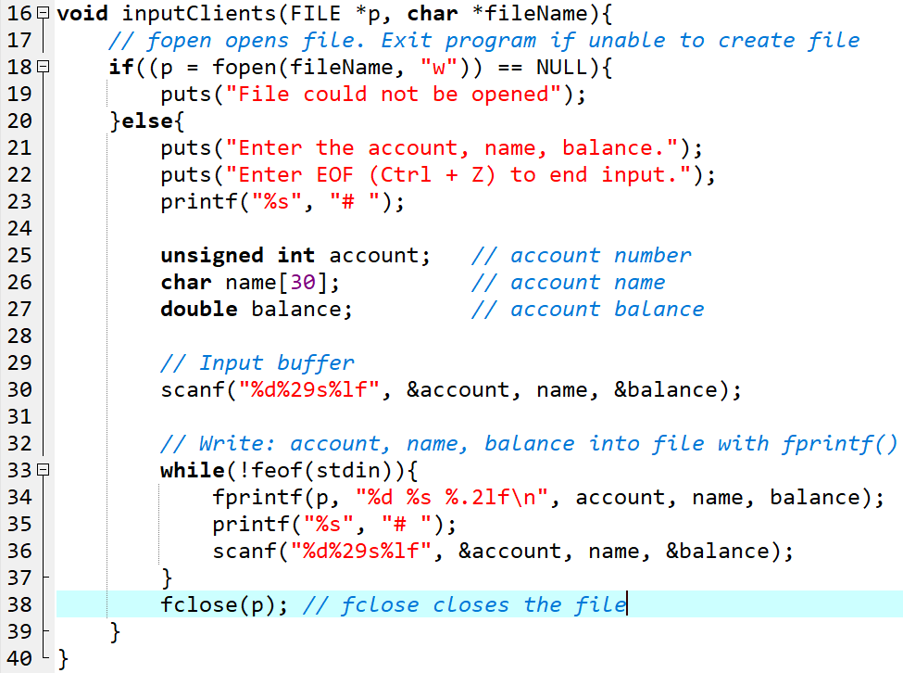
Demo (cont.)

Slide 30
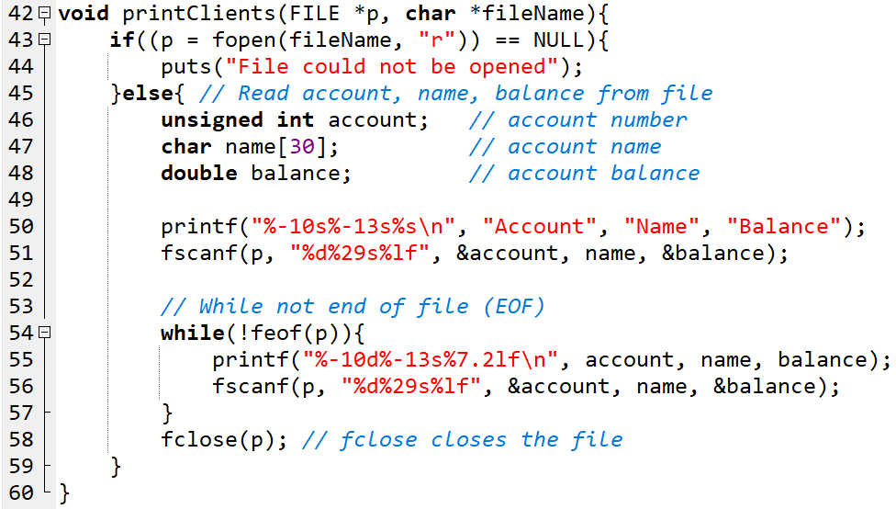
Demo (cont.)

Slide 31
4.6. Write to a Binary File
When writing data to a binary file, use the fwrite() function. This function allows us to store information in binary form, comprising sequences of bits (0s and 1s).
Syntax:
Parameters:
ptr: A reference to the memory block holding the data intended for writing.
size: The byte size of each element to be written.
nmemb: The count of elements to be written.
file_pointer: The FILE pointer associated with the output file stream.
Return Value: returns the number of objects successfully written
size_t fwrite(const void *ptr, size_t size, size_t nmemb, FILE *file_pointer);

Slide 32
4.7. Reading from Binary File
When retrieving data from a binary file, use the fread() function. This function facilitates the extraction of data from the file in its binary representation.
Syntax:
Parameters:
memory_ptr: A pointer to the memory block where the data will be stored.
size: The size of each element to be read (in bytes).
nmemb: The number of elements to be read.
file_pointer: The FILE pointer pointing to the input file stream.
Return Value: The function returns the number of objects successfully read.
size_t fread(void *memory_ptr, size_t size, size_t nmemb, FILE *file_pointer);

Slide 33
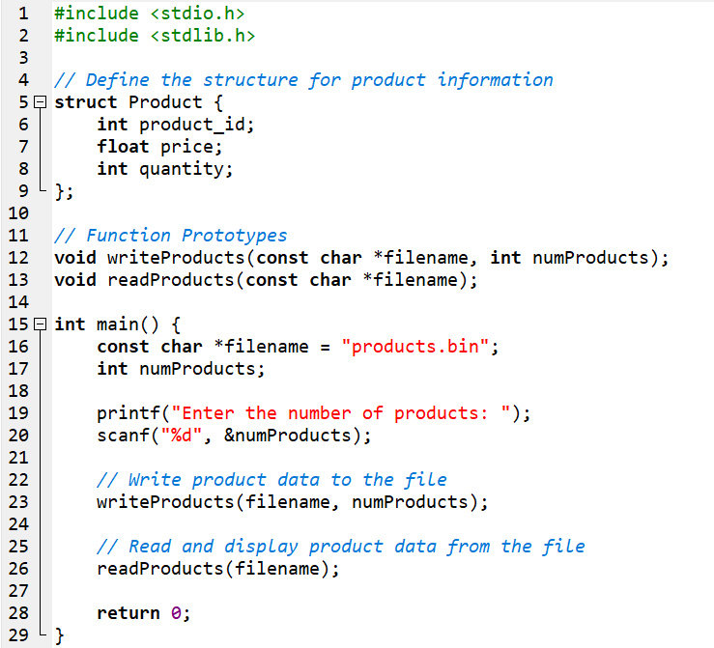
Write and Read Binary File: Demo
Development of a program to manage ‘n’ product. Each product includes the following information: Product code, Price and quantity.
Requirements:
Enter product information from the keyboard and save it to a binary file
Read data from the binary file and Print out a list of products

Slide 34
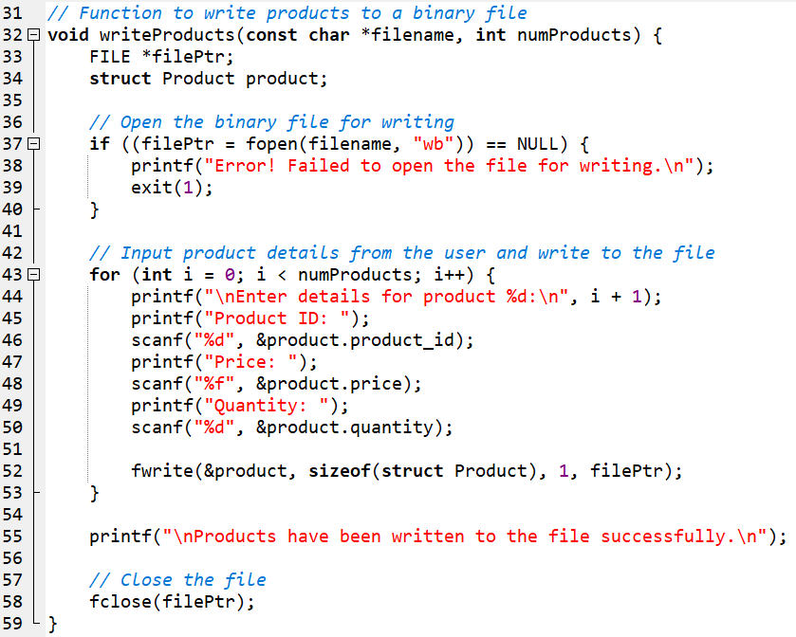
Write and Read Binary File: Demo
Write to binary file

Slide 35
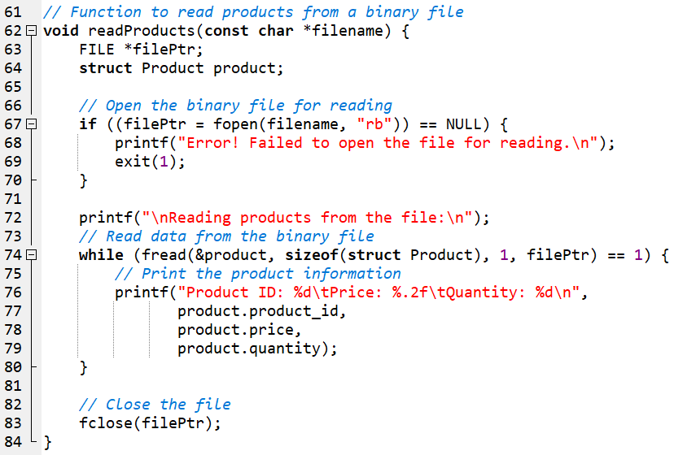
Write and Read Binary File: Demo
Read to binary file

Slide 36
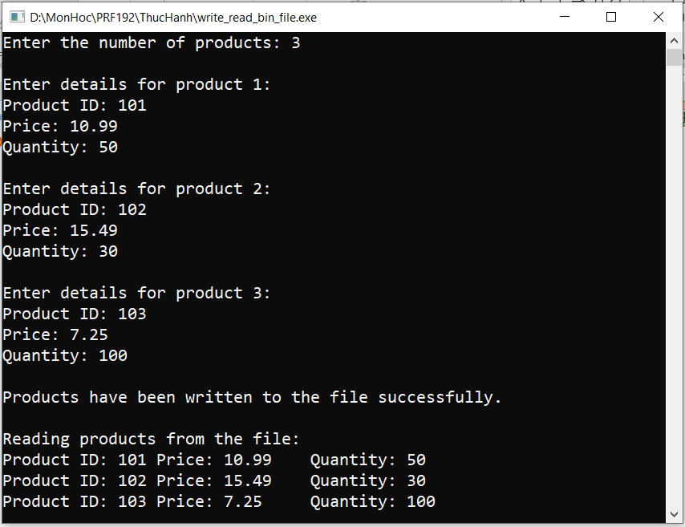
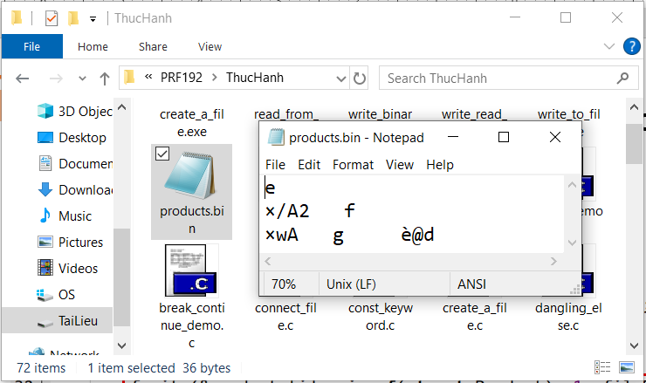
Write and Read Binary File: Demo
Input from keyboard and Write to file
Read from file and Print out

Slide 37
4.8. Moving to a specific location in a file: fseek()
The fseek() function in C is used to move the file pointer to a specific location in a file.
It allows you to read or write from any position in a file, making it a powerful tool for random-access file operations
Syntax:
Return Value:
Returns 0 on success.
Returns a nonzero value on failure.
int fseek(FILE *file_ptr, long int offset, int pos);

Slide 38
fseek()
Parameters:
file_ptr: A pointer to the file object (returned by fopen()).
offset: The number of bytes to move the file pointer.
pos: Determines the position from where the offset is applied. It can be:
SEEK_SET: Beginning of the file.
SEEK_CUR: Current position of the file pointer.
SEEK_END: End of the file.
Common Use Cases:
Jump to a specific location in a file.
Skip over sections of a file.
Read or write from a specific position in a file.

Slide 39
rewind() function
The rewind() function in C is used to move the file pointer back to the beginning of a file.
Unlike fseek(), which requires parameters, rewind() is a simple way to reset the file pointer to the start of a file.
Syntax:
Parameter:
file_pointer: A pointer to the file object, which must have been opened by fopen()
Return Value: does not return a value
void rewind(FILE *file_pointer);

Slide 40
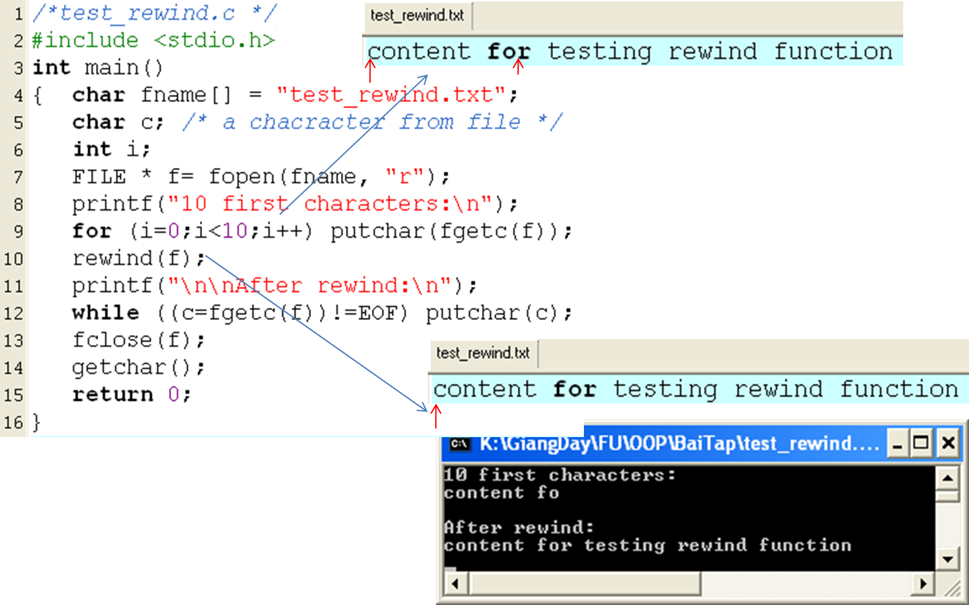
Demo: rewind(FILE*)

Slide 41
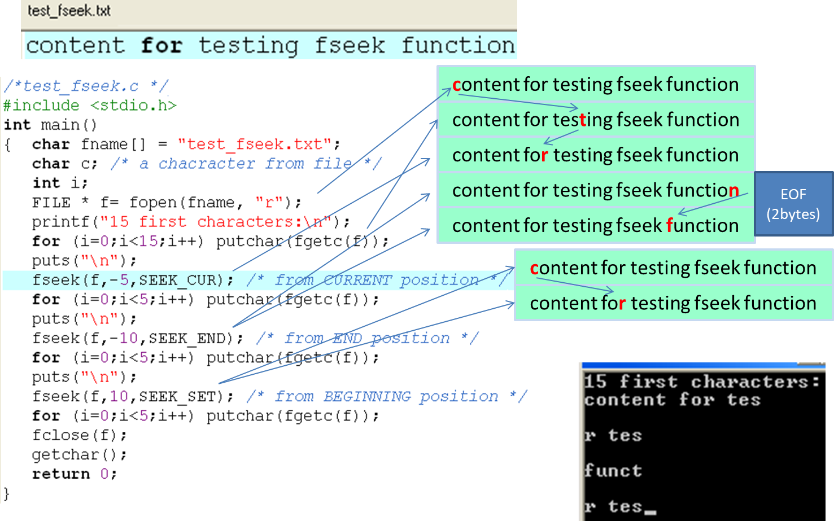
Demo: fseek(…)

Slide 42
Summary
Understand what a file is? The role of files in storing data on secondary memory.
Types of Files in C
Using C language to work with Files
Open/Close files
Read and write data to/from text files and binary files
Move the pointer to work with data in files

